Slide 1
Introduction to the
Personal Project
What is it?
Examples
Timeline
Guidebook
Supervisors
FAQs

Slide 2
The Personal Project
The PP is an exploration into something that you’re passionate about, want to know more about, get better at, or enjoy!
Spans all of 10th Grade
Mirrors senior project
Journal along the way
Integrates IB Philosophy
Check in with faculty supervisor
Show off your journey in the Spring

Slide 3
Personal Project Examples
Create a hover board
  http://www.youtube.com/watch?v=ppjK0R8X7lo
Learn to make a stop motion animation
  http://www.youtube.com/watch?v=r7WcWqy_cno
Organize a Flash Mob on health
  http://www.youtube.com/watch?v=eFHfZ_AOkqs
Choreograph and perform a Dance
  http://www.youtube.com/watch?v=vtks9S5vE9E
Design and conduct an experiment
  http://www.youtube.com/watch?v=efBsc3ZRrwM
Promote your City
  http://www.youtube.com/watch?v=be7snj7SdQ0
Create anti-bullying campaign
  http://www.youtube.com/watch?v=4BpL_xMBQtE
Direct & Film an informational video
  http://www.youtube.com/watch?v=uhA6I4IgykM
More examples in your handbook!

Slide 4
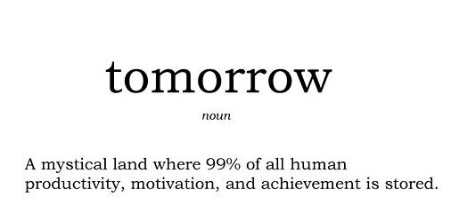
Timeline
Open your handbook to p. 5
  Contains guidance, due dates
Plan Ahead!
Don’t let this be you!

Slide 5
Guide Book
p. 3-4: Descriptor of PP
p. 5: timeline
p. 6-7: how to focus your topic
p. 9-15: how will my PP be assessed?
p. 17: Supervisor Commitment Form

Slide 6
Guide Book
Guide Book can be found on the Personal Project Moodle Page
  No user name/password needed
  http://moodle.shaker-heights.k12.oh.us/course/view.php?id=652#section-0

Slide 7
Supervisors
A teacher will help guide you along the way
Will meet at least 5 times in the year:
  Introduce and confirm relationship (by 9/26)
  Goals/Ideas for your project (between 9/26-11/7)
  Final topic & area of focus (between 11/7-12/12)
  Process Journal (12/12-2/6)
  Process Journal & Final Product (2/6-3/6)
Supervisor will eventually grade your project
  p. 9-15 to see how you’re going to be graded

Slide 8
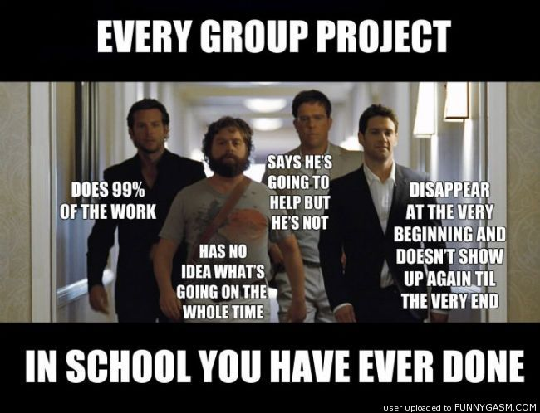
FAQ 1: Can we work in a group?
No…and a little bit of yes
  Your project & journal are your own
  You may have help to complete it
This is why
no group projects

Slide 9
FAQ 2: Can I fail it?
No – your supervisor will help to ensure that you do not fail
  Your assessment scores reflect where you are currently in your ability to set-goals, critically think, stick to a project, and succeed!
  If you are worried, see your advisory teacher (that’s us!) or your supervisor

Slide 10
Other Questions?

